Slide 1

DriverPass System Analysis
John Vowcicefski
Notes:
“Hello, I’m John Vowcicefski and this is a quick PowerPoint related to the DriverPass system”

Slide 2

System Requirements
Functional Requirement 1: The system shall enable easy scheduling of on-road training sessions.
Functional Requirement 2: The system shall provide interactive online learning modules.
Nonfunctional Requirement 1: The system shall maintain high performance even under heavy user load.
Nonfunctional Requirement 2: The system shall be adaptable to future enhancements without significant rework.
Notes:
"Our system is built with key requirements to serve DriverPass’s mission. Functionally, it will simplify booking lessons and accessing educational content. Non-functionally, we've focused on ensuring that the system is both high-performing and flexible for future growth."

Slide 3
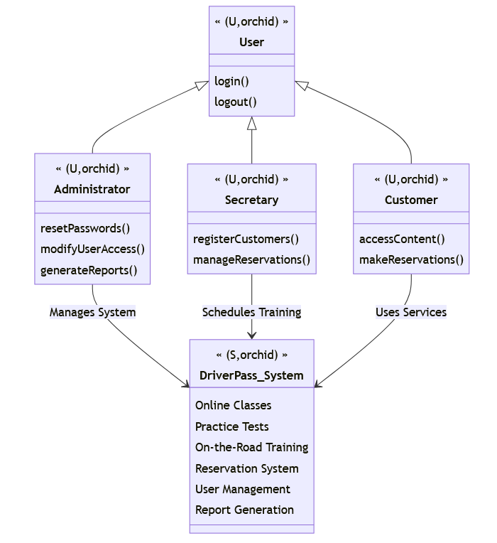
Use Case Diagram
Notes:
"This diagram outlines the journey of our users, from signing up for a course to completing their training. We've mapped out how customers, instructors, and administrators interact with our platform, ensuring a seamless experience."

Slide 4
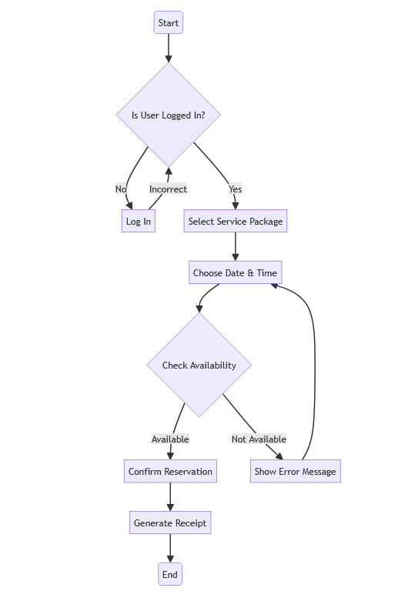
Activity Diagram
Notes:
"In this visual guide, we're walking through the process a student follows to book a driving lesson. It starts with the student logging in to their account. Next, they select the 'Book a Lesson' option, choose their preferred date and time from available slots, and finally, they review and confirm their booking. This process was designed with DriverPass's aim to make booking lessons as easy and straightforward as possible."

Slide 5
Security
Secure sign-in every time you access our services.
Extra protection for your account beyond just a password.
Continuous monitoring for unusual activity to protect against intruders.
Straightforward steps to recover your account, just in case you forget your password.
Notes:
"When it comes to using DriverPass, your safety and privacy come first. We've taken care to ensure that every time you log in, your personal details are kept under lock and key. Think of it as a safety belt for your online information. If there's any hint of someone trying to get into your account, we batten down the hatches and let you know immediately.

Slide 6
System Limitations
Currently designed for web-based interactions.
Dependence on reliable internet connectivity.
Scheduled updates during off-peak hours.
Notes:
"Like any system, we have limitations. Our services are currently web-based and depend on internet access. We schedule updates during low-traffic periods to minimize inconvenience or our users. Currently, it requires an internet connection – it's not yet available for offline use. Think of updates as road maintenance; we do this during quiet hours, so it won't disrupt your journey. And just as roads expand to accommodate more traffic, we'll evolve and improve our system by listening to your experiences and suggestions."

